Slide 1
PRESENT
Organizing and structuring a project

Slide 2
1. Save your project in a single folder.

Slide 3

my_project
description
data
tools
manuscript

Slide 4

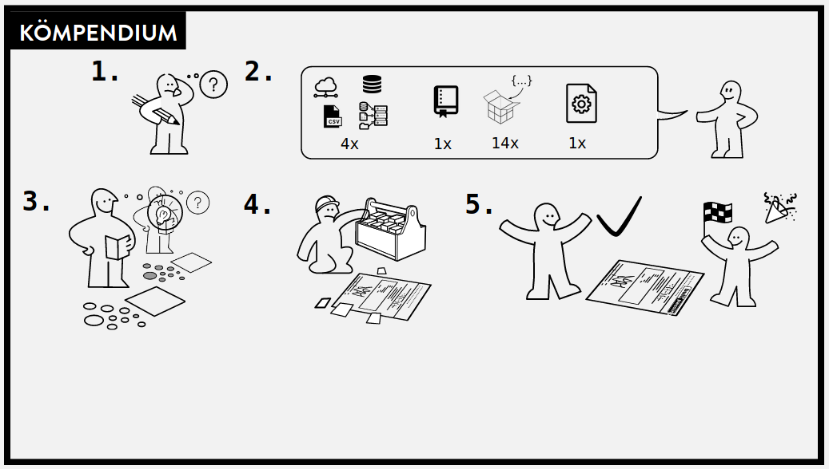
Credit: Scriberia for The Turing Way
Credit: Karthik Ram

Slide 5
2. Devise a logical system of sub-folders.

Slide 6


README.md
LICENSE
data/
raw/
RAW_DATA_FILE001.zip
(…)
RAW_DATA_FILE331.zip
clean/
mydata.csv
R/
mycode.R
results/
images/
figure1.tiff
figure2.tiff
analysis/
table1.csv
docs/
documentation.md
manuscript.md
README.md
LICENSE
data/
mydata.csv
analysis/
report.md

Slide 7
README.md
LICENSE
data/
raw/
RAW_DATA_FILE001.zip
(…)
RAW_DATA_FILE331.zip
clean/
mydata.csv
R/
mycode.R
results/
images/
figure1.tiff
figure2.tiff
analysis/
table1.csv
docs/
documentation.md
manuscript.md
README.md
LICENSE
data/
mydata.csv
analysis/
report.md
Automatically generated
Human written
Read-only

Slide 8
README.md
LICENSE
data/
raw/
RAW_DATA_FILE001.zip
(…)
RAW_DATA_FILE331.zip
clean/
mydata.csv
R/
mycode.R
results/
images/
figure1.tiff
figure2.tiff
analysis/
table1.csv
docs/
documentation.md
manuscript.md
README.md
LICENSE
data/
mydata.csv
analysis/
report.md
Automatically generated
Human written
Read-only

Slide 9
README.md
LICENSE
data/
raw/
RAW_DATA_FILE001.zip
(…)
RAW_DATA_FILE331.zip
clean/
mydata.csv
R/
mycode.R
results/
images/
figure1.tiff
figure2.tiff
analysis/
table1.csv
docs/
documentation.md
manuscript.md
README.md
LICENSE
data/
mydata.csv
analysis/
report.md
Automatically generated
Human written
Read-only

Slide 10

(CC0)

Slide 11
3. Introduce the project (or sub-folder) in a README.

Slide 12
Documentation through README
What is the project about?
Who are involved?
How was the data collected?
When & where is the research conducted?
Other inspiration…
Abbreviations
Folder structure
File explanations
References & links

Slide 13
4. Use interoperable file types.

Slide 14
Demo: show excel file in excel and save it as a csv
Open the csv file in a plain text editor
Same with word

Slide 15
5. Use descriptive and logical file names.

Slide 16
File naming
File names should be
Machine readable
Human readable
Logically sortable
Credit: Jenny Bryan

Slide 17
File naming
Avoid spaces, accents, odd punctuation...
Use delimiters (hyphens, underscores) for easy separation of elements
File names should be
Machine readable
Human readable
Logically sortable
Use informative elements so that files can be easily found
Credit: Jenny Bryan

Slide 18
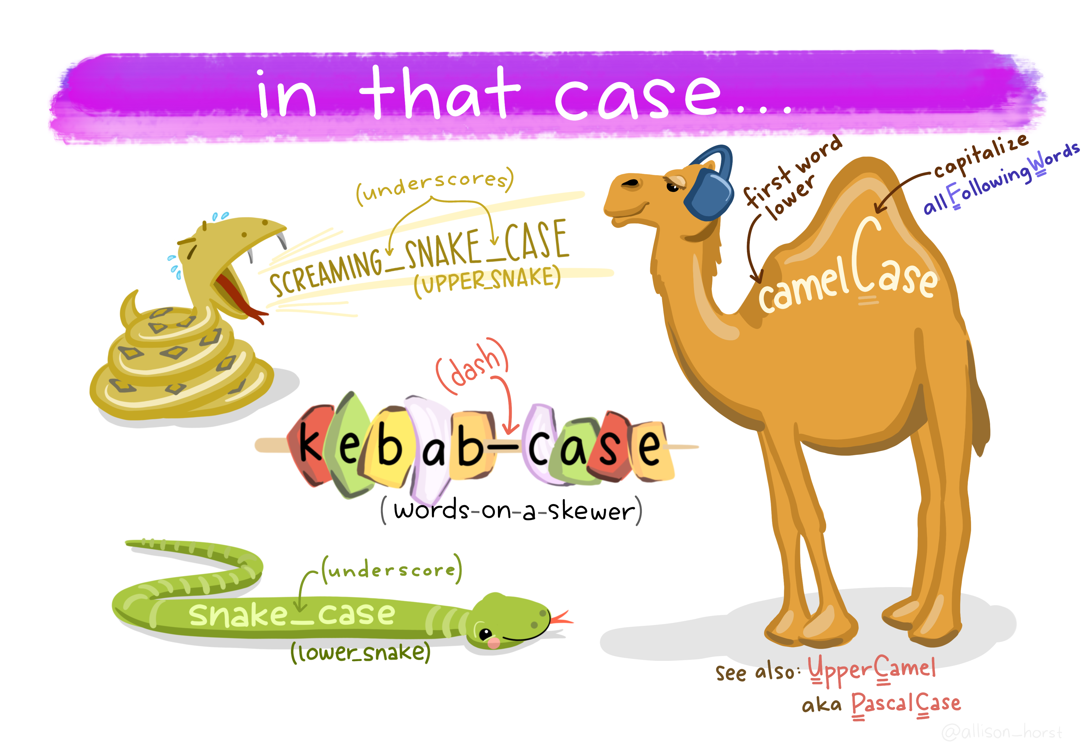
Credit: Allison Horst

Slide 19
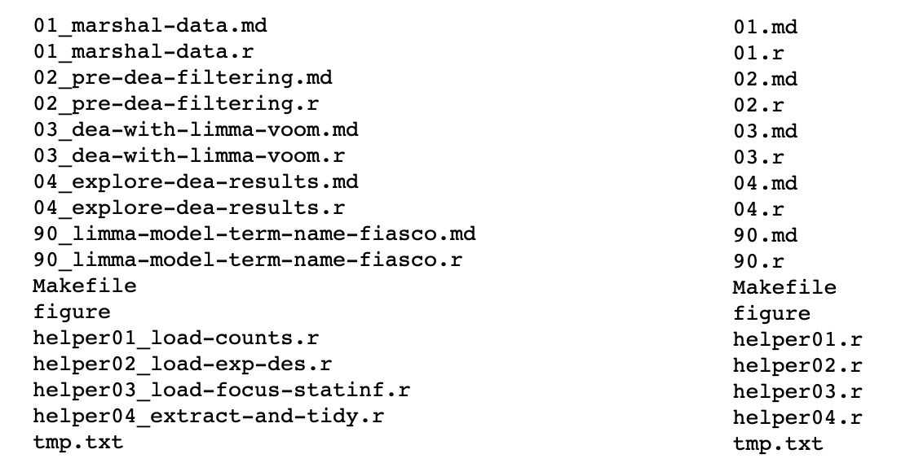
File naming
Which set of file(name)s do you want at 3 AM before a deadline?
File names should be
Machine readable
Human readable
Logically sortable
Use informative elements
Credit: Jenny Bryan

Slide 20
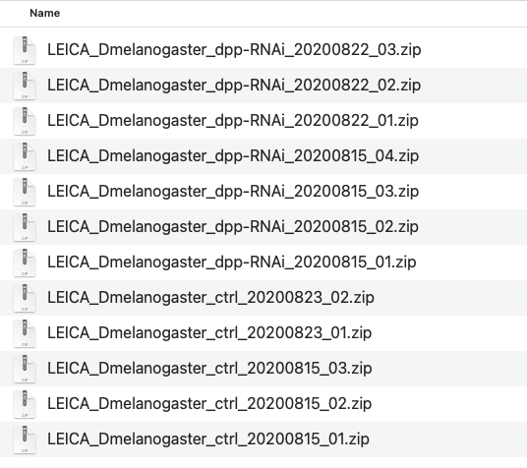
File naming
File names should be
Machine readable
Human readable
Logically sortable

Slide 21
6. Make your data tidy.

Slide 22

Visualization credit: Illustrations from the Openscapes blog Tidy Data for reproducibility, efficiency, and collaboration by Julia Lowndes and Allison Horst

Slide 23
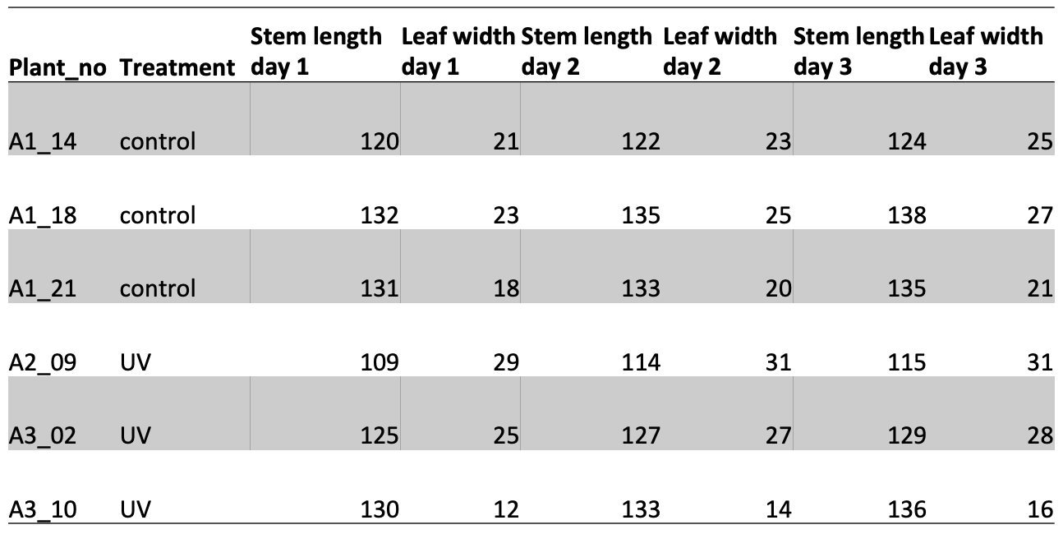
An example of untidy data: plant measurements

Slide 24
An example of untidy data: plant measurements
Values in column names

Slide 25
An example of untidy data: plant measurements
Multiple observations in a single row

Slide 26
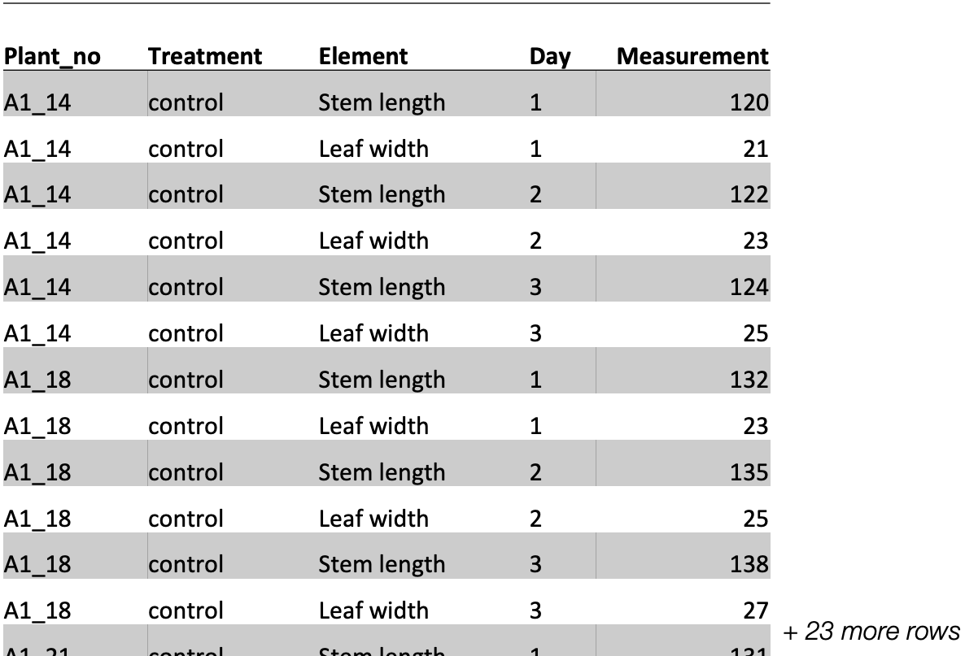
Same data, now in a tidy format

Slide 27
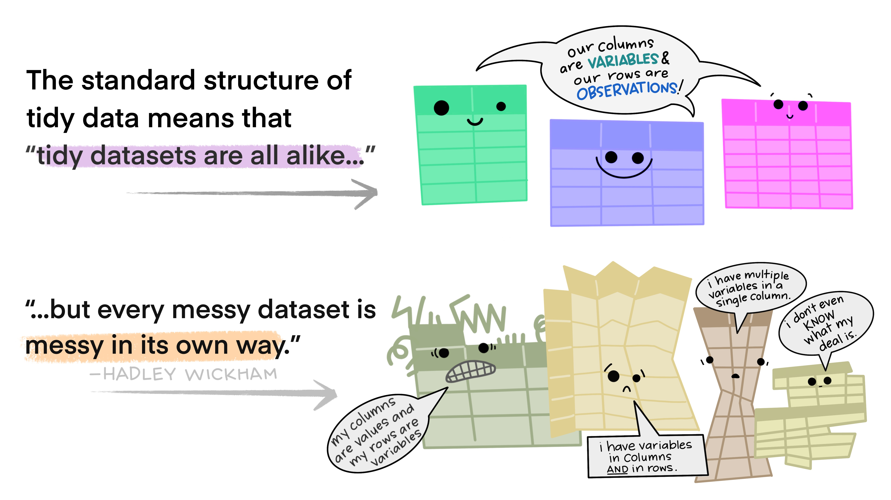
Visualization credit: Illustrations from the Openscapes blog Tidy Data for reproducibility, efficiency, and collaboration by Julia Lowndes and Allison Horst

Slide 28
Save your project in a single folder
Devise a logical system of sub-folders
Introduce the project in a README
Use interoperable file types
Use descriptive and logical file names
Make your data tidy

Slide 30
PAST
Recording project history

Slide 31
A
A
B
*
A
A
*) Thanks to: , but not
time goes on…
Notes:
Keeping track of your project history is important in many situations. If at a
later stage, you want to make sure that you understand the status quo at a
certain date, it is crucial that you kept track of your project's history
throughout its lifetime. For example: imagine your project, project A, is the
basis of someone else's project, project B. Project B uses project A in its latest and
most up-to-date state. But you continue working on project A and make several
updates. For project B, simply referring to project A will probably not be
sufficient. It would be useful instead to be able to refer to project A in a way
that makes it clear what the state was when the project was used.
In this section we are going to look into ways that you can keep track of your
project history. We will be using tools that you already understand.

Slide 32

Notes:
There are
more sophisticated tools out there, that we do want to recommend you look into.
Using dedicated version control software (such as Git) is easier than you may
think, and it is supported by many text editors and has several graphical
interfaces as well. Git is one of those tools that will save you so much time in
the long run and it is absolutely worth the time investment.
Let’s start with the basics though.

Slide 33
1. Keep a changelog

Slide 34
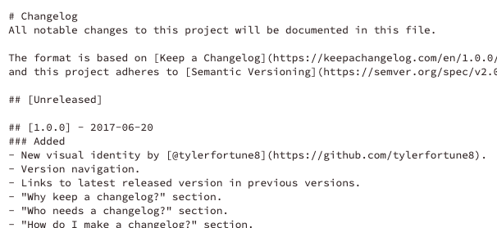
Changelog: an example from keepachangelog.com
Notes:
A changelog is a dedicated file where you keep track of the history. This file
lives in the root of the project. The changelog describes important changes you
made to the project throughout its lifetime. These changes are always
accompanied by the date they were implemented. Descriptions in a change log need
not be complicated or elaborate, but they are an important reference for changes
that were made in the past, and when.
A changelog typically sorts changes into types: Added, for new features.

Slide 35
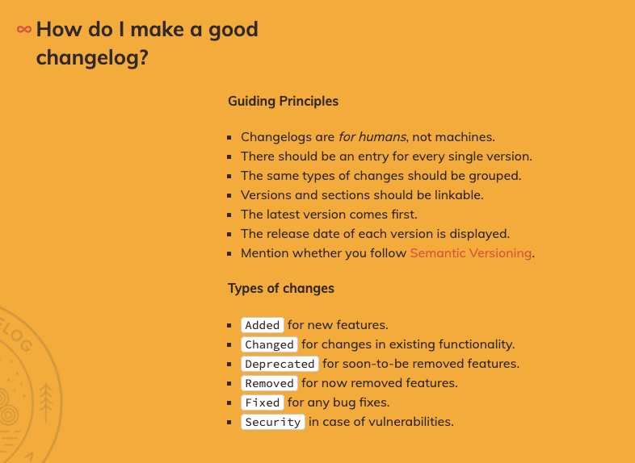
Credit: keepachangelog.com
Notes:
A changelog typically sorts changes into types: Added, for new features.
Changed, for changes in existing functionality. Deprecated, for soon-to-be
removed features. Removed, for now removed features. Fixed, for any bug fixes.
Security, in case of vulnerabilities.

Slide 36
2. Formalize updates using semantic versioning

Slide 37
Semantic versioning
patch
1.0.2
major
minor
semver.org/spec/v2.0.0.html
Notes:
When substantial changes have been made it can be useful to release a new
version of the project. You may have seen version numbers associated to software
or other projects in the past. They usually consist of three elements, and these
three numbers have their own meaning. First is the major version, then the minor
version, finally a patch number. This system is called semantic versioning. Not
every project follows these rules, but they are quite common, so these rules are
likely a useful reference when interpreting other projects version numbers.

Slide 38

Semantic versioning
. .
major
minor
patch
A
A
Minor update:
Major update:
1.3.0
2.0.0
?
A
B
A
B
1.2.0
1.2.0
semver.org/spec/v2.0.0.html
Notes:
This is what they mean: the patch number is updated when small repairs to the
project are made, or bugs are fixed. If new aspects of the project are added,
new functionality is introduced, then the minor version is updated. Importantly,
if another project, project B, uses your project, project A, and project B was
made using project A version 1.2.0, then an update in the minor version, to
version 1.3.0 should not break project B. In other words: new things can be
added, but a minor version change signals that nothing that worked before has
been affected.
If there is a big change, and, for example, an existing part of the project is
altered, then this warrants a major version change. At this point, the minor and
patch numbers go back to 0. If project B was built with project A version 1.2.0,
then project A version 2.0.0 no longer guarantees that it works the same way.

Slide 39
Your first version
patch
0.1.0
major
minor
semver.org/spec/v2.0.0.html
Notes:
Using the number zero is a fully legitimate way to number versions. It does have
a specific role to play. The major version zero is reserved to indicate that
this project is still in its initial development. Thus, a common first version
of a project is 0.1.0. This is usually a project that is under development, but a
version is out that is ready to be shown to the world.
Once a version is released, any updates made to the project will be for the next
version. Did you make a new version release, only to realize you made a typo? That's your first
patch.

Slide 40
Your first version
Typo!
0.1.1
major
minor
semver.org/spec/v2.0.0.html
Notes:
Using the number zero is a fully legitimate way to number versions. It does have
a specific role to play. The major version zero is reserved to indicate that
this project is still in its initial development. Thus, a common first version
of a project is 0.1.0. This is usually a project that is under development, but a
version is out that is ready to be shown to the world.
Once a version is released, any updates made to the project will be for the next
version. Did you make a new version release, only to realize you made a typo? That's your first
patch.

Slide 41
Changelog: an example from keepachangelog.com
Notes:
With every version change, you obviously update the changelog. What relevant
things happened between the previous version and now?

Slide 42

Not-so-semantic versioning: via phdcomics.com
Notes:
You may not think your project is worthy of versioning. Think back to the last
time you wrote a manuscript. Did it look anything like this? Those are versions,
too. They're just not properly standardized.

Slide 44
FUTURE
Publishing and archiving your project for future use

Slide 45
1. Choose a license.

Slide 46



Slide 47
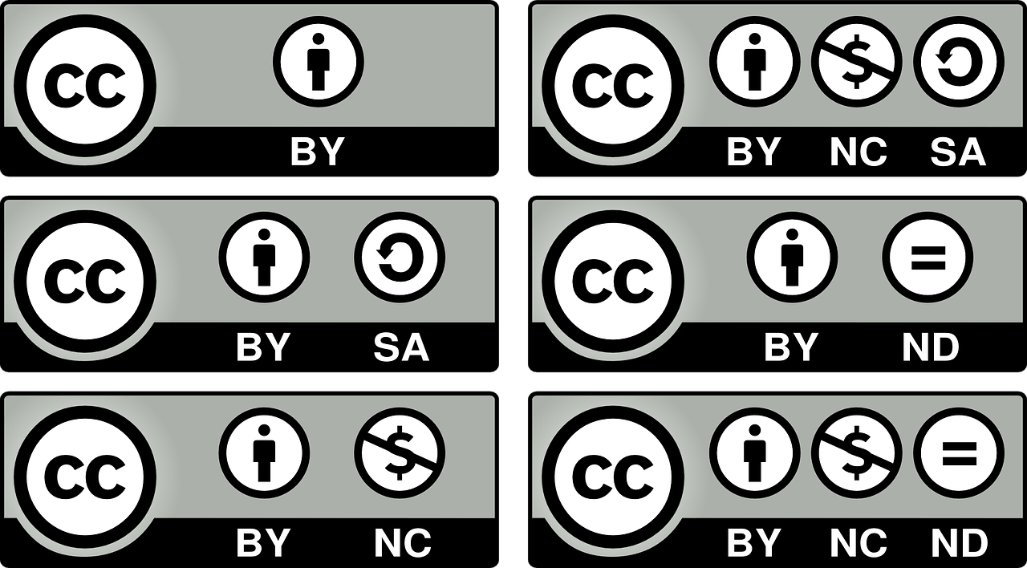

Slide 48





Copyleft vs Permissive

Slide 49
What open licenses are NOT
You will not be forgotten.
You are not forbidden from making money!

Slide 50
2. Maintain your living project on GitHub.

Slide 51
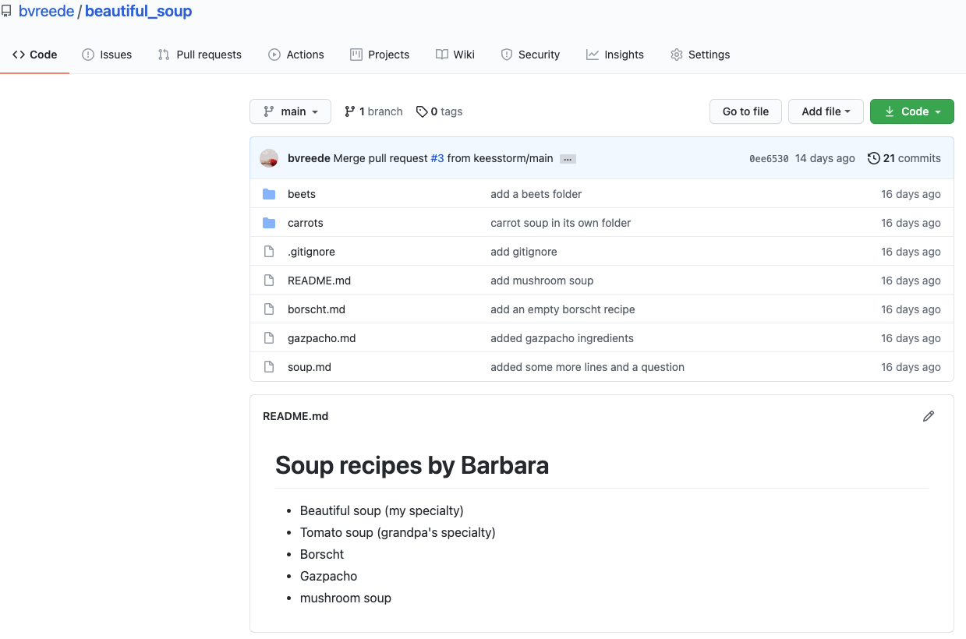
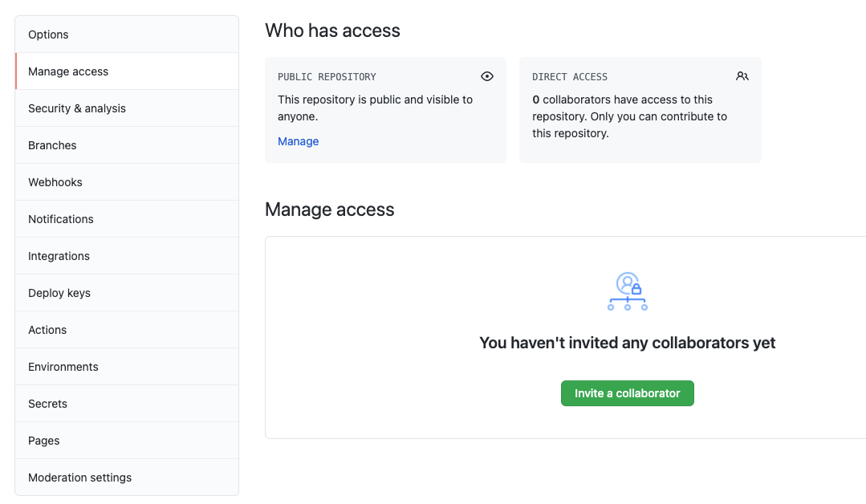
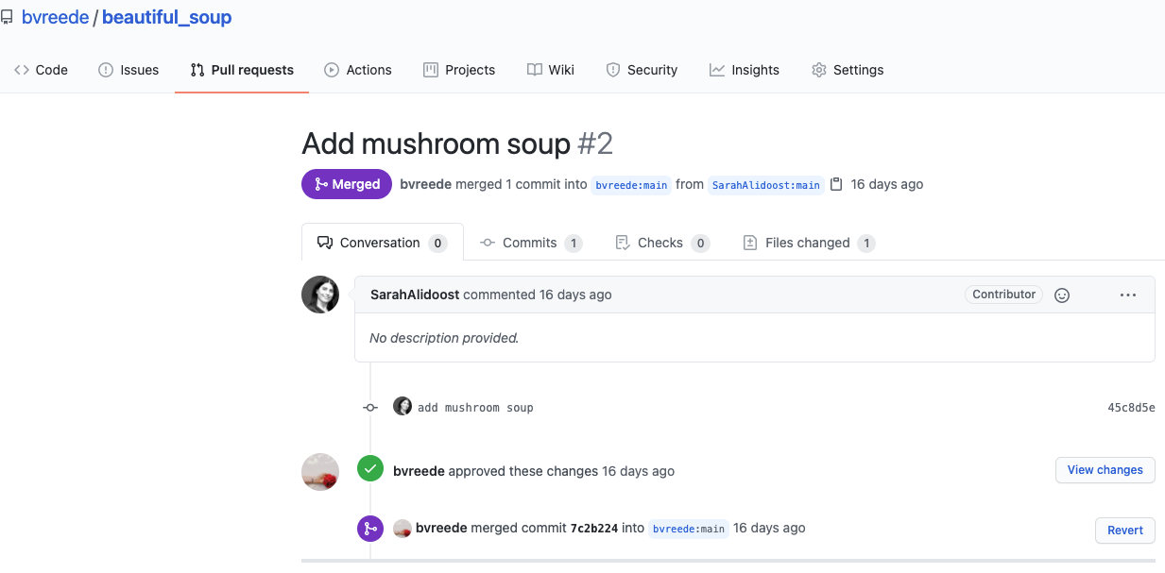

A repo:

Slide 52
A pull request, resulting from a fork:

Slide 53
Inviting collaborators in ‘settings’ > ‘manage access’

Slide 54
Showcasing
README right on the
front page!

Slide 55
3. Archive the project for posterity on Zenodo.

Slide 56
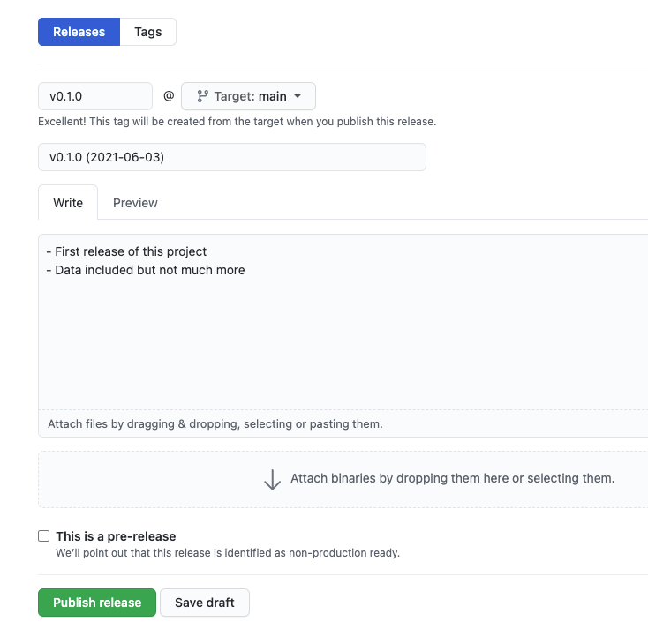
A release in GitHub…

Slide 57

… can automatically archive to Zenodo!

Slide 58
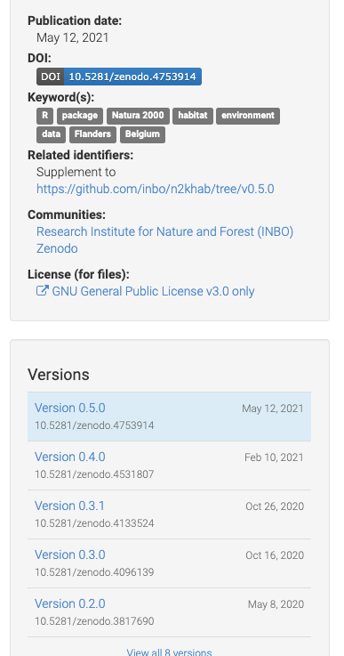
Digital Object Identifier (DOI)
License
Older versions

Slide 60
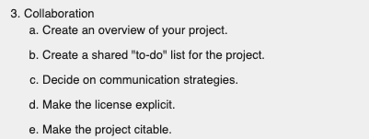
Publish an active project on GitHub

Slide 61
Choosing a license

Slide 62
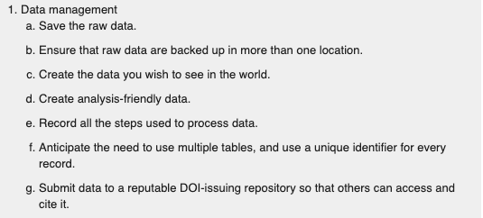
Archive project on Zenodo

Slide 63
Citing a project

Slide 64
Reproducibility

